Slide 1
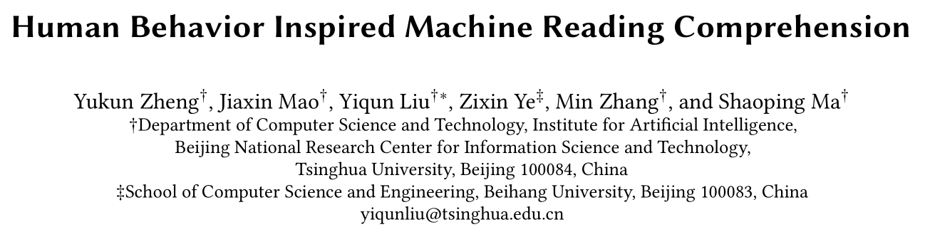

Slide 2
RQ1 : How do humans read and seek answers during reading comprehension tasks?
RQ2 :What factors affect the attention allocation mechanism of human beings during reading comprehension tasks?
RQ3 : Can learning from features of human behavior (e.g., eye tracking) help improve the performance of MRC tasks?

Slide 3
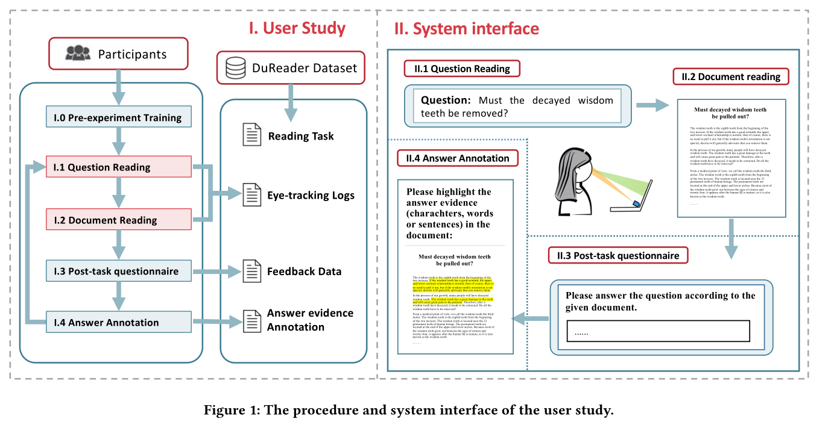

Notes:
从 DuReader选15个问题，过滤掉段落不在3-20之间的文章，最后保证每个问题有4篇文章。大部分文章中都能提供答案信息，一部分文章中是没有答案的。然后分成四组（每个问题的四篇中取一篇文章合成一组），参与者每次看到的是一个问题和一篇文章。32个人， 15美元。
读问题—要求复写一遍，确保记住了
读问题和文章的时候会记录视觉和鼠标数据。屏幕上的坐标和停留时长。
在问卷里写下答案，不能是靠自己的常识，必须来源于文章。没有答案写None，5个层次
之后再看问题和文章，标注支持答案的区域， 还要标注这篇文章是否有用4个层次

Slide 4
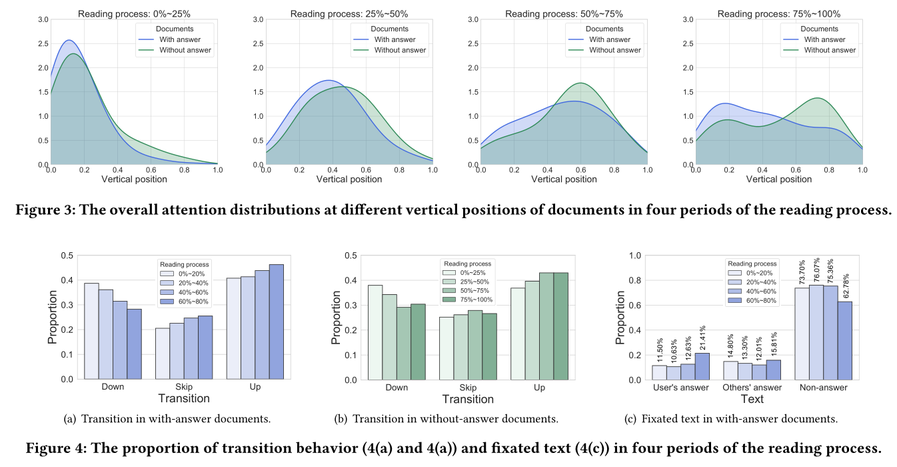

Slide 5
Answer seeking
Read from top to bottom and continue reading to the end , although may have examined some snippets of answer evidence.
Read the top line by line and gradually skim with more skip and up transition behavior.

Slide 6
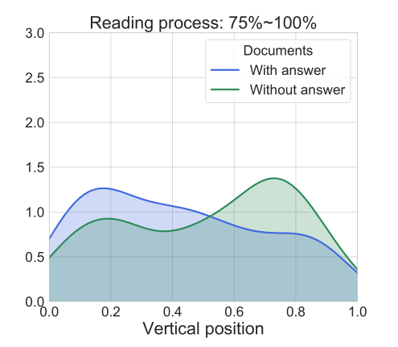
Answer Verification
With answer
Reread the document
Without answer
First peak: verify the judgement that there is no answer in the doc.
Second peak: try to find answer and leave reading with no answer.
Users will reread more snippets of candidate answers with more skip and up transition behavior in the with-answer documents to make an answer verification before generating their final answers.
User may also review the documents after reading the whole document but found no answer in the without-answer documents.
Notes:
With answer
Without answer

Slide 7
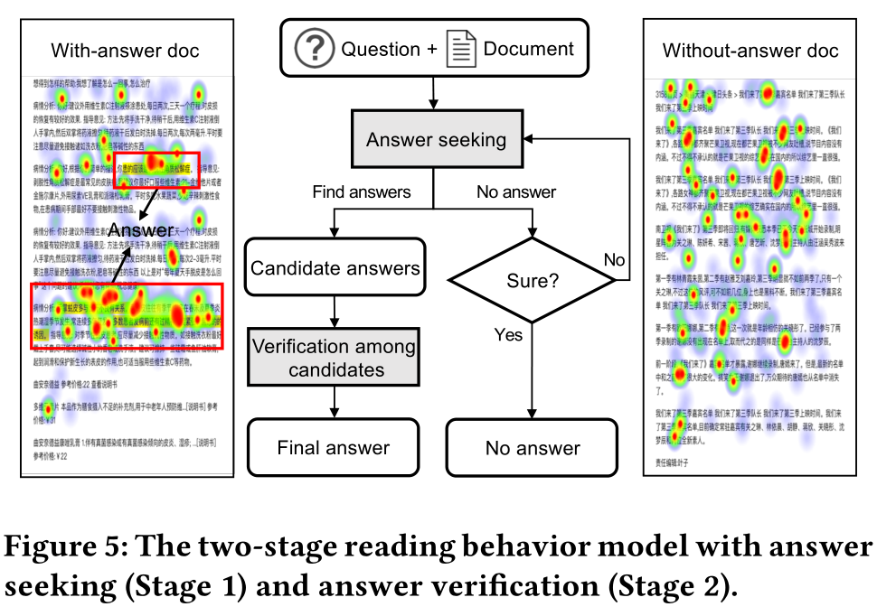

Slide 8
RQ2 :What factors affect the attention allocation mechanism of human beings during reading comprehension tasks?
Answer
Position
Lexical categories
Matching signal

Slide 9
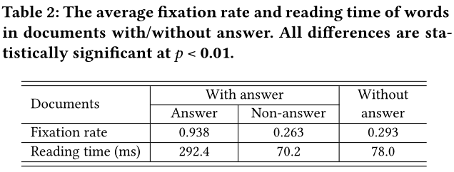
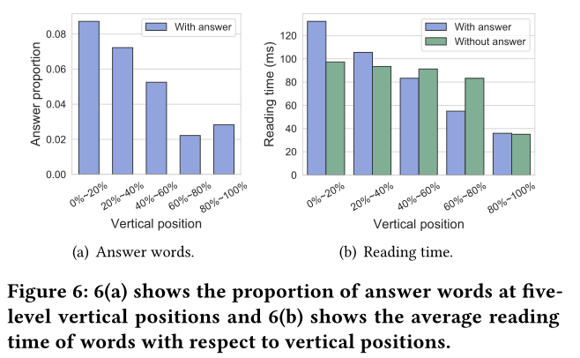
1.Answer
Users tend to pay more attention to read answer word than non-answer word.
2.Position
The distribution of reading time at five-level vertical positions is similar to the distribution of answer words and their Pearson correlation coefficient is 0.966, indicating that human attention is biased by both vertical positions and answer locations.

Slide 10
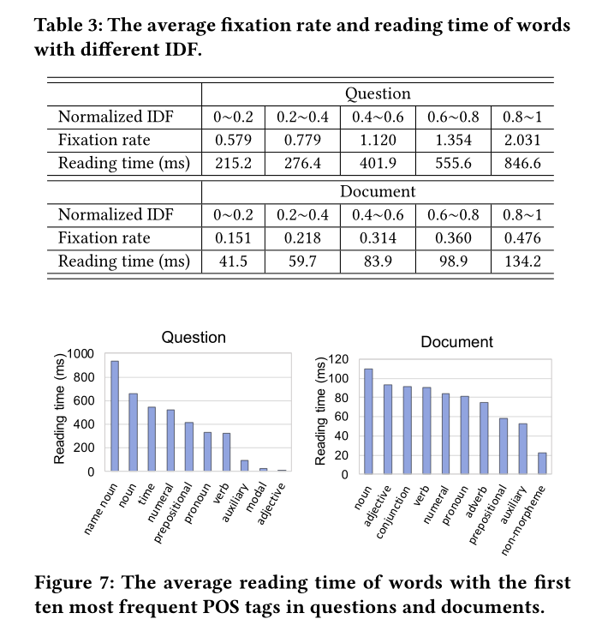
3.Lexical Features
Low-frequency words attract more attention than high-frequency words when users are reading both questions and documents.
Users tend to pay more attention to nouns during reading both questions and documents. (nouns usually contain useful and important information.)

Slide 11

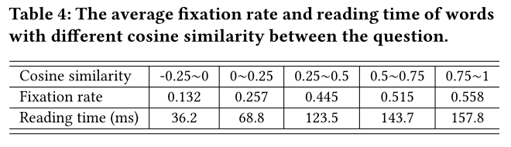
4. Matching Signal
Advanced neural MRC models capture the matching signals be-
tween the question and the document based on word embeddings.
Words that are more semantically similar to the question usually attract more human attention.

Slide 12
RQ3 : Can learning from features of human behavior (e.g., eye tracking) help improve the performance of MRC tasks?
The experiment is conducted at the sentence level.
1. Use the valid features in the two-stage reading behavior model to predict the human attention signals of sentences within a document.
2. Feed the predicted attention as a feature into answer sentence retrieval models to compare with baseline models.

Slide 13
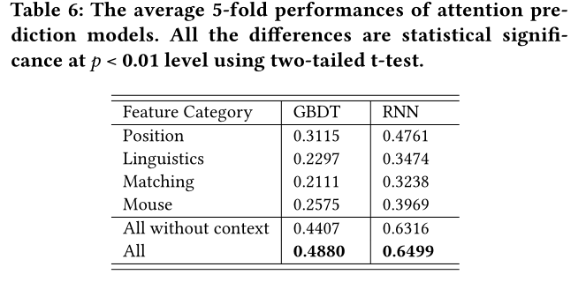
Attention Prediction
The label of this task is the average reading time of words in a sentence (range from 0 to a few seconds).
The task is regarded as a regression problem using Gradient Boosting Regression Tree (GBRT) and an RNN-based neural regression model.

Slide 14
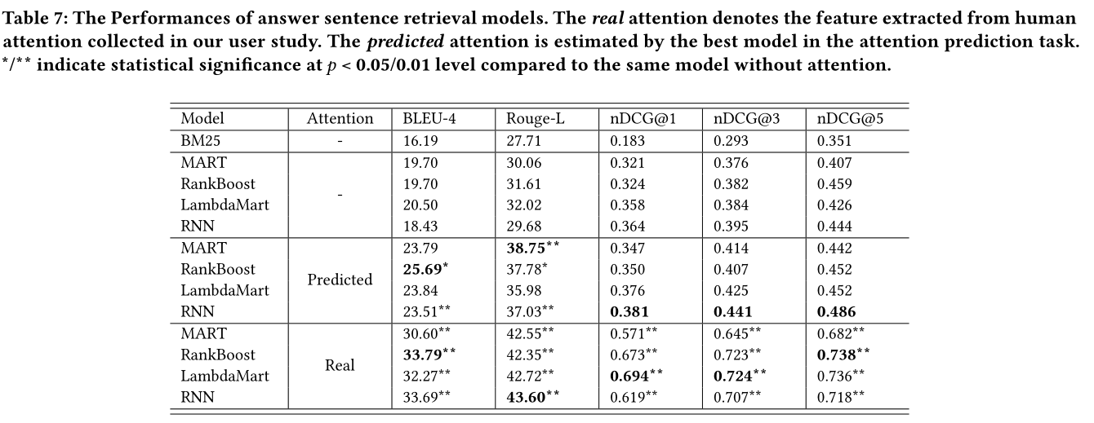
Answer Sentence Retrieval
The label of this task is the annotation rate of sentences, which is scaled into three grades: 0 ← 0, 1 ← (0, 0.5], 2 ← (0.5, 1], which account for 83.4%, 13.2% and 7.4% respectively.
Notes:
这个指标通常是用来衡量和评价搜索结果算法

